Slide 1

Blog Creation Using CrewAI Multi-Agents
By: Biswas Poudel, Amit Kumar

Slide 2
Agenda
Problem Statement
Context
Solution Approach
Technology Stack
Experiments & Results
Observations
Conclusion
Future Work

Slide 3

Problem Statement
Streamlining Content Creation

Slide 4
Problem Statement
Manual Blog Creation is time-consuming
Quality and relevance of content can vary
Need for automation to handle diverse topics
Not an expert on multiple topics

Slide 5

Context
Testing LLM’s Abilities

Slide 6
Context
Leveraging AI and multi-agents frameworks to streamline content creation
Increasing demands for timely and relevant blog content
Goals: Quality, Efficiency, and Scalability in blog production

Slide 7
Solution Approach
Agents are Cool!

Slide 8
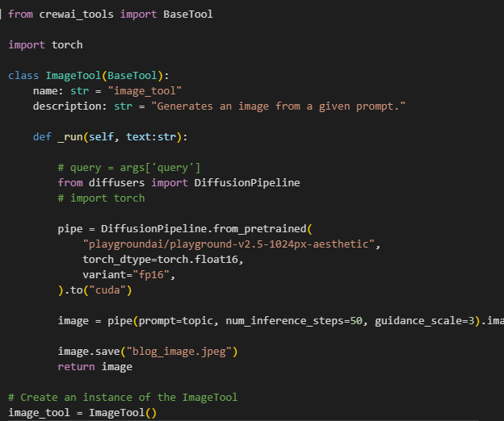
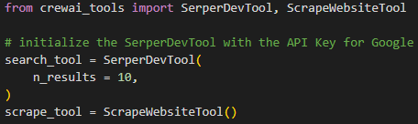
Solution Approach
Utilized CrewAI for agent-based task management
Agents: Research, Blog writer, Image Generator, Editor
Tools: SerperDev, ScrapeWebsite, Image_tool (custom)
Tasks: Research task, Writing task, image generation task, editing task

Slide 9
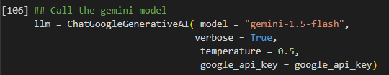
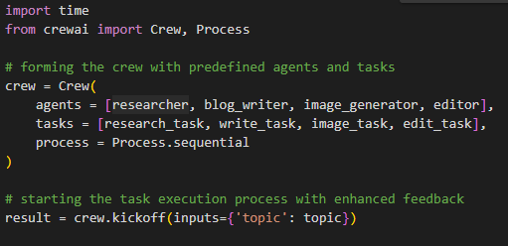
Tech Stack
CrewAI
Google gemini-1.5-flash
Hugging face (for image-generation)
SerperDevTool(), ScrapeWebsiteTool()
Python libraries (diffusers, langchain,Ipython, display)

Slide 10
Experiments
Topics variety: Sports, Politics, Economics, AI, etc
OpenAI, Gemini,
Running the same query again
Image generation
Delegation: True/False

Slide 11
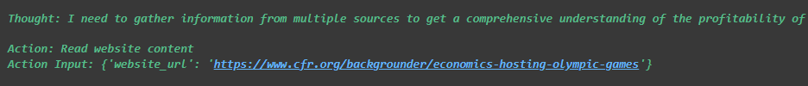
Results & Observations
Looping on the same search query or search result
Inconsistent quality of Blog content
Resource Exhausted, Weird Errors
Got stuck in seemingly never-ending loops
Limited processing of search results, often reusing a few link

Slide 12

Results & Observations

Slide 13
Conclusion
Content Creation Jos are SAFE!!

Slide 14

Conclusion
Shows potential, but needs refinement
Requires better coordination among the Multi-agents
Improvements in query handling and content quality

Slide 15
Future Work
Breaking out of looping issues
Ensure thorough processing of all search results
Consider customized or fine-tuned blog writing models
Enhance coordination among agents
Better image generation models

Slide 16

Questions??
Thank You!

